Slide 1

Systematic Qualitative Analysis
Of organic compound (UREA)
Rohan Singh
University of Delhi, Ramjas College
B.Sc.(Hons) Chemistry, Sem-6, Sec-B, RolL No-107

Slide 2
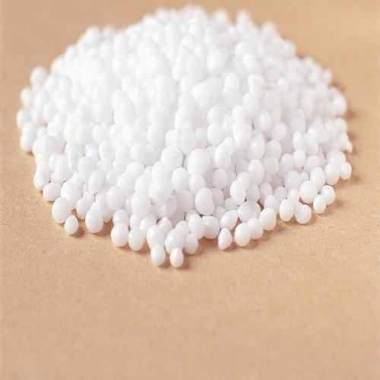
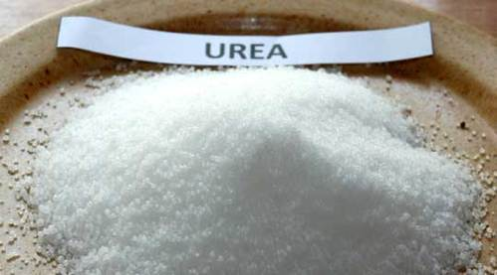
Urea
Urea is white crystalline solid and is odourless, soluble in cold and hot water.
1

Slide 3
Preliminary Analysis
TEST | OBSERVATION | INFERENCE
a. Physical State b. Colour c. Odour d. Flame (Ignition) Test Introduce ~5g of compound on metal spatula on low blue flame until it got burnt completely | Crystalline Solid White Odourless Non sooty flame with smell of ammonia | Carboxylic acids, Carbohydrates, Amides, Nitro phenols and higher Hydrocarbons may be present. Carboxylic acids, Simple amides, Carbohydrates may be present. Carbohydrates, Aromatic acids, Amides may be present. Compound is Aliphatic, most likely amide
2

Slide 4
TEST | OBSERVATION | INFERENCE
e. Solubility Test 1. Water (Cold and Hot) 2. NaHCO3 solution 3. Dilute NaOH solution 4. HCl solution 5. Conc H2SO4 solution f. Unsaturation Test 1. Baeyer’s Test Compound (0.5 g) + 1mL water + 0.5 mL of dilute Na2CO3solution + 1-2% of aq KMnO4 Solution dropwise 2. Bromine Solution Test Compound (0.5 g) + 1mL water + 2% of Bromine solution in water dropwise with shaking | Soluble Insoluble Insoluble Soluble Soluble No colour discharge No colour discharge | Lower Acid, Amide or Carbohydrate may be present Acidic group absent Acidic and Phenolic group absent Basic group present (may be amide) Basic group present (may be amide) Compound is saturated Compound is saturated
3

Slide 5
Extra Element Detection (N, S and X)
TEST | OBSERVATION | INFERENCE
a. Test for Nitrogen (FeSO4 test) 2mL of sodium extract + 1mL freshly prepared FeSO4 solution (if a dark green ppt is not formed, add 2-3 drops of NaOH solution to make it alkaline). Boil gently for a minute. Add 3-4 mL dil H2SO4 solution to hot mixture. b. Test for Sulphur 1. Lead Acetate Test 2mL of sodium extract + 2mL of dil Acetic acid + 4-5 drops of Lead Acetate solution. 2. Sodium Nitroprusside Test 1mL of sodium extract + 2-3 drops of freshly prepared Sodium Nitroprusside solution. | Prussian blue colour No black precipitate observed No violet colouration observed | Nitrogen confirmed Sulphur absent Sulphur absent
4

Slide 6
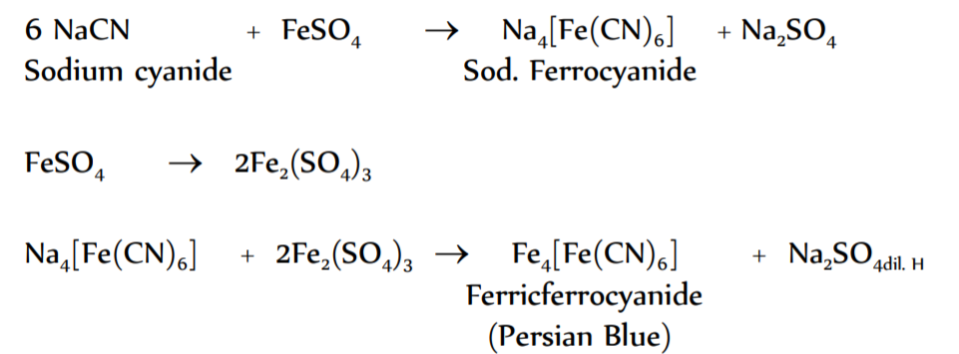
TEST | OBSERVATION | INFERENCE
c. Test for Halogens 2 mL of sodium extract + conc nitric acid. Boil and Cool. Add Silver nitrate solution | No precipitate observed | Halogen absent
REACTION (FeSO4 test for Nitrogen)
3
5

Slide 7
Functional Group Detection
Functional Groups Without Extra Elements
TEST | OBSERVATION | INFERENCE
a. Carboxylic Acid 1. Litmus Test Added blue litmus paper in aqueous solution of compound 2. NaHCO3 Test Added small amount of compound in 2 mL cold saturated NaHCO3 solution. b. Alcohol 1. CAN Test 0.5 mL solution of compound in water + 2-3 drops of Cerric Ammonium Nitrate solution. | No colour change No effervescence observed No red colouration observed | Carboxylic acid may be absent Carboxylic acid absent Alcohol absent
6

Slide 8
TEST | OBSERVATION | INFERENCE
c. Phenol 1. nue FeCl3 Test Added 1-2 drops of neutral FeCl3 solution in very dilute solution of compound d. Carbonyl Group (2, 4 DNP Test) Added 10-12 mL of 2, 4 DNP reagent in 2-3 drops of solution of compound in water. Shaken vigorously and heated in water bath for 5-10 minutes. Allow to stand it for 5-10 minutes. e. Ester 1. Phenolphthalein Test To 1 mL of solution of compound in water, added 2 drops of phenolphthalein and dil NaOH solution dropwise till pink colour persist. f. Carbohydrate 1. Molisch’s Test 0.05 g of compound + 2 mL water + 3 mL of freshly prepared Molisch’s reagent (10% ethanoic α-napthol). Shaken well. Poured 2-3 mL of conc sulphuric acid along sides of test tube. | No blue/ green/ violet/ brown colour observed No precipitate observed No discharge of pink colour No voilet ring observed | Phenol absent Carbonyl group absent Ester absent Carbohydrate absent
7

Slide 9
Functional Groups With Extra Element (Nitrogen)
TEST | OBSERVATION | INFERENCE
a. Amide Group 1. Hydrolysis Test 5 mL 10% NaOH solution was added to 0.5g of compound and boiled. (Test evolution of ammonia by placing a red litmus paper OR a glass rod dipped in HCl on mouth of test tube OR by passing gas through Nessler’s reagent (Potassium tetraiodomercurate(II) )). 2. Hydroxamic Test (Unsubstitued amide) Added NH2OH.HCl solution and ethanol in 0.5g of compound. Boiled for 2-3 minutes and cool. Added 4-5 mL of freshly prepared FeCl3 solution. 3. Biuret Test (Urea and mono substituted Urea) Heated 0.5g of compound gently until melted substance just solidifies. Ammonia will be evolved leaving white solid (Biuret) behind. Dissolved Biuret in warm water and 1mL 10% NaOH solution. Added few drops of very dil CuSO4 solution. | Ammonia evolved. (Turns red litmus paper to blue, or white fumes of NH4Cl appears when came in contact with HCl, or turns Nessler’s reagent brown) Colour changes from red to violet Violet/Purple colour observed | Amide group confirmed Unsubstitued amide group confirmed Urea (or mono substituted urea) confirmed
8

Slide 10


REACTIONS
Hydrolysis Test
Biuret Test
9

Slide 11
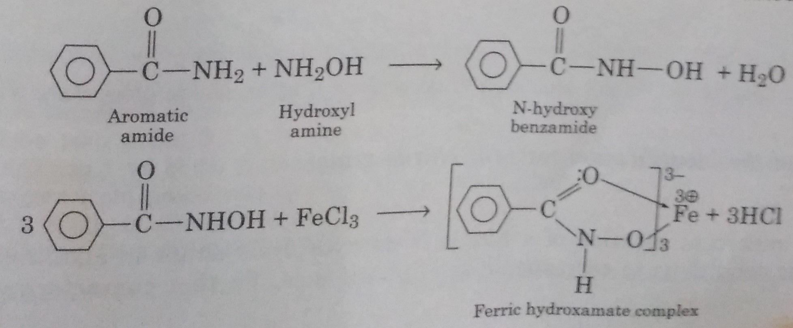
Hydroxamic Test
10

Slide 12
Melting Point and Probable Compounds
Melting Point
Melting point can be measured either by kjeldahl’s method or by electrically heated apparatus. Meting range of compound is determined when it starts melting and when it melts completely. Most probable melting point range for Urea is ≈ 130-131 °C
Probable Compounds
Compound | Melting Point
Urea | 132 °C
Isobutyramide | 129 °C
Succinamide | 126 °C
Isovaleramide | 136 °C
Note : Out of above compounds, only Urea gives positive Biuret test. So most probable compound is Urea.
11

Slide 13
Preparation of Derivatives
Urea is a monoacid base. It reacts with acids to produce corresponding salts.
Urea Oxalate
Urea reacts with Oxalic acid (simplest dicarboxylic acid) to produce crystalline salt, Urea Oxalate which has a sharp melting point of 171 °C.
Preparation
3 mL of conc aqueous solution of Oxalic acid was added to 3 mL of aqueous solution of Urea (Cool the mixture in ice bath while stirring since it is exothermic). Crystals of Urea Oxalate separates out of reaction mixture. Recrystallized with dilute ethanol.
Melting Point
Melting point of recrystallized derivate is most probably ≈ 170-172 °C.
It is in close agreement with that of Urea Oxalate (171 °C).
12

Slide 14
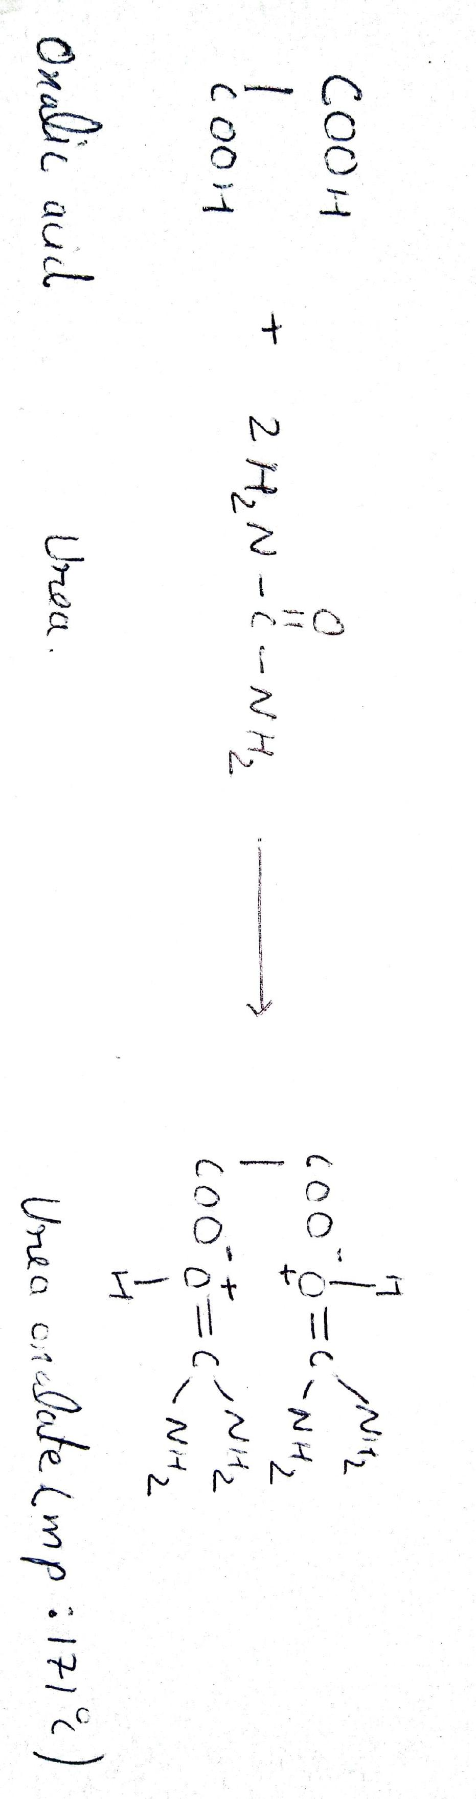
Reaction
13

Slide 15
Urea Nitrate
Urea reacts with conc Nitric acid to produce explosive salt Urea Nitrate which has a melting point of 163°C.
Preparation
3 mL of conc Nitric acid solution was added to 5 mL of conc aqueous solution of Urea (Cool the mixture in ice bath while stirring since it is exothermic). Allowed the reaction mixture to stand for 5 minutes. Filtered the reaction mixture to obtain Urea Nitrate. Recrystallized with dilute ethanol.
Melting Point
Melting point of recrystallized derivate is most probably ≈ 162-164 °C.
It closely corresponds to Urea Nitrate (163°C).
14

Slide 16
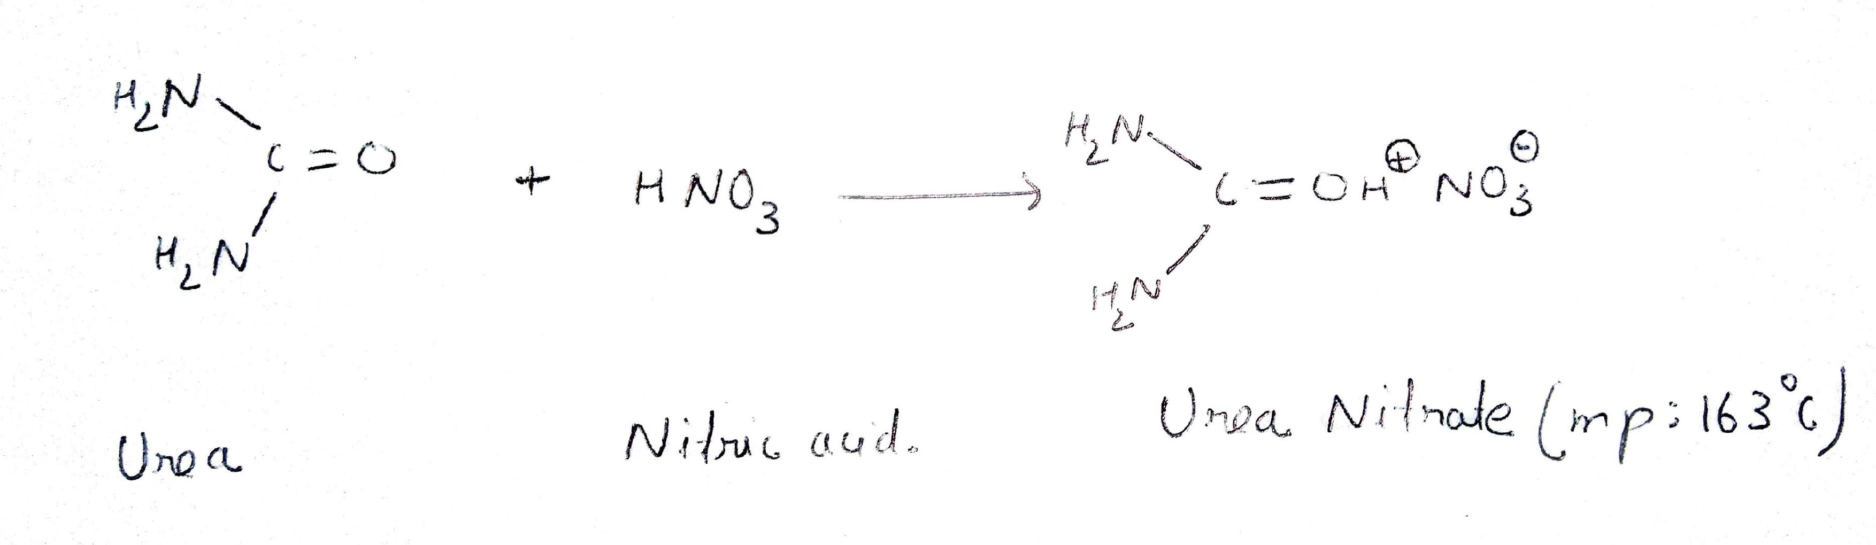
Reaction
15

Slide 17
Result
The given organic compound is identified as Urea.
16

